Slide 1

ProQuest Dissertations&Theses Global
Ne için ve Nasıl kullanılır?
Tezlerin keşfi ve yaygınlaştırılması için en güvenilir araç
Ocak 2019
“Doktora Öğrencileri ve Doktora Derecesi almış kişiler için”

Slide 2
Oturumun Amaçları
Tez ve Tezlerin önemini kavramanız,
ProQuest Dissertations&Theses veri tabanında arama yöntemleri hakkında bilgi sahibi olmanız,
ProQuest Dissertations&Theses veri tabanında en iyi aramayı gerçekleştirip aradığınız içeriğe ulaşmanız,
Platform üzerinde yapabileceğiniz; sonuçları filtreleme, arama uyarısı oluşturma, atıf bilgisi oluşturma, PDF olarak belgeyi kaydetme konularında,
Ve bunun gibi platformun bir çok işlevi hakkında bilgi sahibi olmanız.
Notes:
Points for Understand the importance of the Dissertations and Theses
As a source of relevant information for academic research
As a guide to write a better thesis
As a helping tool to avoid plagiarism
Keep yourself updated in your own subject domain - We should mention the alerts

Slide 3

ProQuest Dissertations & Theses Global
TÜM TÜRKİYEDEKİ ÜNİVERSİTELER PROQUEST DİSSERTATİONS&THESES GLOBAL VERİTABANINDAKİ TEZLERE TUBITAK ULAKBIM ARACILIĞIYLA ERİŞMEKTEDİR!
Notes:
Quick note about a couple of the terms I’ll be using . . .
As you may know, PQDT stands for ProQuest Dissertations and Theses. The “Global” is there to make clear that we have dissertations from all over the world. Most of the time, I’m just going to refer to the product by its initials: PQDT.
Also, when I say dissertations, I will be using the term as a shorthand for both dissertations (i.e., what PhD students write) and theses (i.e., what master’s students write).
In the most basic terms, then, PQDT is a database that researchers access on the ProQuest platform. It is the largest collection of dissertations in the world. The dissertations are written by graduate students from thousands of institutions in many different countries. As you will see later, some of these students have gone on to do important research. A few of them are even household names.

Slide 4
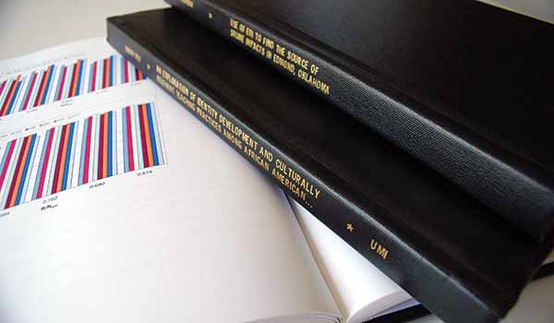
ProQuest Dissertations & Theses Global hakkında
Dünyadaki en büyük tez koleksiyonudur.
4.5 milyondan fazla tez içeriğine sahiptir. Ve platformda 2.4 milyondan fazla tam metin tez bulunmaktadır.
Dünyadaki doktora tezleri ve yüksek lisans tezlerinden geniş bir kolleksiyona sahiptir.
Multidisipliner veritabanıdır: Tüm alanlardaki araştırmacılar için önemli ve değerli bir içerik sunmaktadır.
Notes:
Quick note about a couple of the terms I’ll be using . . .
As you may know, PQDT stands for ProQuest Dissertations and Theses. The “Global” is there to make clear that we have dissertations from all over the world. Most of the time, I’m just going to refer to the product by its initials: PQDT.
Also, when I say dissertations, I will be using the term as a shorthand for both dissertations (i.e., what PhD students write) and theses (i.e., what master’s students write).
In the most basic terms, then, PQDT is a database that researchers access on the ProQuest platform. It is the largest collection of dissertations in the world. The dissertations are written by graduate students from thousands of institutions in many different countries. As you will see later, some of these students have gone on to do important research. A few of them are even household names.

Slide 5
ProQuest Dissertations & Theses Global hakkında
Tezler, birçok farklı ülkede binlerce kurumdan lisansüstü öğrenciler tarafından yazılmıştır.
PQDT Global'in içerik ortakları arasında Londra Üniversitesi, Londra Ekonomi ve Siyaset Bilimi Okulu, Cardiff Üniversitesi, Leicester Üniversitesi, Aberdeen Üniversitesi, Bath Üniversitesi ve Valencia Üniversitesi bulunmaktadır.
The Library of Congress’in resmi tez deposudur ve National Library of Canada’nın yayıncı ortağıdır.
Notes:
Quick note about a couple of the terms I’ll be using . . .
As you may know, PQDT stands for ProQuest Dissertations and Theses. The “Global” is there to make clear that we have dissertations from all over the world. Most of the time, I’m just going to refer to the product by its initials: PQDT.
Also, when I say dissertations, I will be using the term as a shorthand for both dissertations (i.e., what PhD students write) and theses (i.e., what master’s students write).
In the most basic terms, then, PQDT is a database that researchers access on the ProQuest platform. It is the largest collection of dissertations in the world. The dissertations are written by graduate students from thousands of institutions in many different countries. As you will see later, some of these students have gone on to do important research. A few of them are even household names.

Slide 6
2018 Yılında En Çok İndirilen Master Tezleri:
Sıralama | Pub. No. | Başlık | Yazar | Üniversite Adı | Yıl
1 | 1503912 | Reforming the criminal justice system: A pragmatic approach to building a sustainable system | Smith, Da'Mon J. | University of Central Oklahoma | 2011
2 | 1531703 | Ethics and business decision-making | Jaunich, Gregory J. | The College of St. Scholastica | 2012
3 | 1464981 | A study of customer satisfaction factors and employee satisfaction in the hospitality industry | Novikova, Ksenia | Southern Illinois University at Carbondale | 2009
4 | 10128932 | The benefits of early comprehensive youth obesity prevention strategies outweigh the costs to consumers and reimbursers | Alver, Amalie | Boston University | 2016
5 | 10265442 | Social Media Use and Its Impact on Body Image: The Effects of Body Comparison Tendency, Motivation for Social Media Use, and Social Media Platform on Body Esteem in Young Women | Puglia, Deanna R. | The University of North Carolina at Chapel Hill | 2017
Notes:
Quick note about a couple of the terms I’ll be using . . .
As you may know, PQDT stands for ProQuest Dissertations and Theses. The “Global” is there to make clear that we have dissertations from all over the world. Most of the time, I’m just going to refer to the product by its initials: PQDT.
Also, when I say dissertations, I will be using the term as a shorthand for both dissertations (i.e., what PhD students write) and theses (i.e., what master’s students write).
In the most basic terms, then, PQDT is a database that researchers access on the ProQuest platform. It is the largest collection of dissertations in the world. The dissertations are written by graduate students from thousands of institutions in many different countries. As you will see later, some of these students have gone on to do important research. A few of them are even household names.

Slide 7
2018 Yılında En Çok İndirilen Doktora Tezleri:
Sıralama | Pub. No. | Başlık | Yazar | Üniversite Adı | Yıl
1 | 3683242 | The Impact of Texting and Social Media on Students' Academic Writing Skills | Risto, Angela | Tennessee State University | 2014
2 | 3592694 | Perceptions of executives from seven selected companies of the use of social media in marketing practices | Alameddine, Abir | Pepperdine University | 2013
3 | 3598537 | Measuring corporate social responsibility through organizational values: A scale validation study | Toliver, Adria Denise | The University of Texas at Arlington | 2013
4 | 10188962 | Social Media and Self-Evaluation: The Examination of Social Media Use on Identity, Social Comparison, and Self-Esteem in Young Female Adults | Solomon, Michelle | William James College | 2016
5 | 3672582 | Rethinking U.S. education policy: Four paradigms of the knowledge economy | Araya, Daniel | University of Illinois at Urbana-Champaign | 2014
Notes:
Quick note about a couple of the terms I’ll be using . . .
As you may know, PQDT stands for ProQuest Dissertations and Theses. The “Global” is there to make clear that we have dissertations from all over the world. Most of the time, I’m just going to refer to the product by its initials: PQDT.
Also, when I say dissertations, I will be using the term as a shorthand for both dissertations (i.e., what PhD students write) and theses (i.e., what master’s students write).
In the most basic terms, then, PQDT is a database that researchers access on the ProQuest platform. It is the largest collection of dissertations in the world. The dissertations are written by graduate students from thousands of institutions in many different countries. As you will see later, some of these students have gone on to do important research. A few of them are even household names.

Slide 8
Akademik araştırmalarda tezin önemi

Slide 9
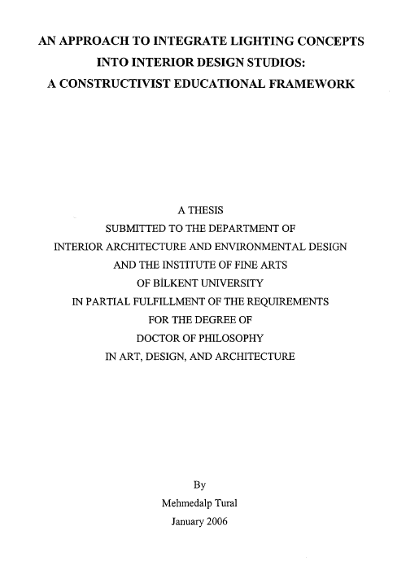
Araştırmalarda neden tezlerden yararlanılmalı?
Tezler, kapsamlı ve özgün bir araştırma sonucunda ortaya çıkan bilimsel ve gözden geçirilmiş çalışmalardır.
1
4
Yeni trendleri ve fikirleri test eder ve sunarlar.
Sık araştırılan ayrıca nadir konular ile ilgili içerik sunarlar.
Tezler, geniş kaynakçalar içeren güncel literatür incelemelerini içerirler.
Daha kapsamlı araştırma verileri içerirler.
Yazma stiline ve formatına örnekler verirler.
Gelecekteki araştırmalarınız için tavsiyeler ortaya koyarlar
2
5
3
6

Slide 10
Kullanıcılar İçin En İyi Arama Uygulamaları

Slide 11
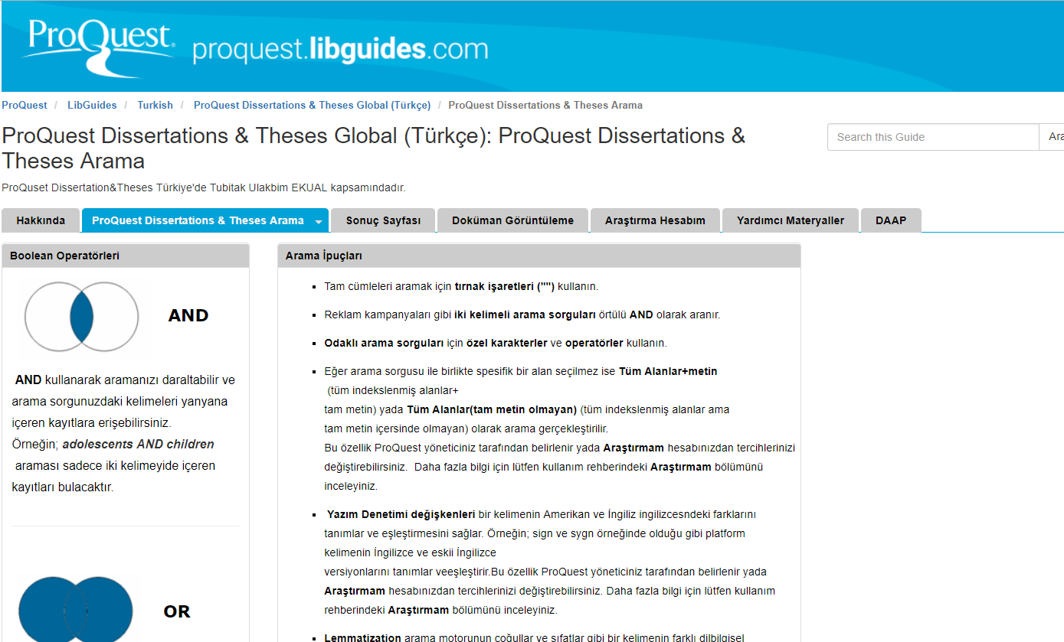
LibGuides
ProQuest Dissertations&Theses Global veri tabanı ile ilgili detaylı bilgi için ProQuest Dissertations&Theses Global Türkçe Libguide sayfasını ziyaret edebilirsiniz: https://proquest.libguides.com/pqdttr/anasayfa
Notes:
Refer to the LibGuide for details on the Search Syntax.
Also mention attending an introduction to the platform webinar if the audience feels need of further training on this.

Slide 12
ProQuest Dissertations&Theses Global erişim linki:
https://search.proquest.com/pqdtglobal

Slide 13
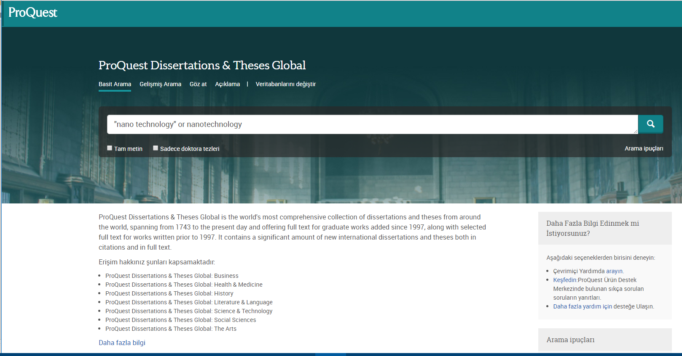
Basit Arama
Notes:
Search across all ProQuest platform databases with the Basic Search. You can search All source types or choose to limit your search by a source type such as Scholarly Journals, Videos & Audio, Dissertations & Theses and others that are available through the More menu. Additionally, you can limit your search to items containing Full text from ProQuest and Peer Reviewed items to only find documents reviewed by subject matter experts. Search Tips are available below the search box and at the bottom of the Basic Search page. Visit the Search Tips and Help Documentation for detailed help on working with operators, fields, special characters. You can also watch our video tutorials, here.
If you want to change your database selection, click on the Databases link at the top of the platform or the databases link under the Basic Search box. This page lists out all the databases that your organization has access to through the ProQuest platform. You can choose multiple databases to cross-search too.

Slide 14
Basit Arama
Basit Arama seçeneği ile tüm içerikte arama gerçekleştirebilirsiniz. Varsayılan arama mantığı, girilen tüm kelimeleri aramaktadır. Tam bir cümle aramak için arama sorgunuzun etrafına tırnak işaretleri ("") koyunuz.
Eğer farklı kelimeleri birleştirme istiyorsanız o zaman OR, AND, NOT bulluon operatörlerini kullanmalısınız.
Arama gerçekleştirildiğinde varsayılan arama mantığı arama sorgusunu “Her yer” de gerçekleştirecektir. “Her yer” tüm bibliyografik kayıtlar (tüm indekslenmiş alanlar) ve tam metinde arama gerçekleştirir. Aynı zamanda hem doktora tezlerini hem de master tezleri ile ilgili sonuçları çıkarır.
Arama gerçekleştirmeden önce bu sayfada Tam metin ve Sadece doktora tezleri filitrelerinden bir veya ikisinide seçerek filtreleme yapabilirsiniz. Ya da arama gerçekleştirdikten sonra sonuç sayfasında çıkan sonuçları gördükten sonra Tam metin ve Sadece doktora tezleri filitreleme seçeneklerinden istediklerinizi seçebilirsiniz.
Notes:
Quick note about a couple of the terms I’ll be using . . .
As you may know, PQDT stands for ProQuest Dissertations and Theses. The “Global” is there to make clear that we have dissertations from all over the world. Most of the time, I’m just going to refer to the product by its initials: PQDT.
Also, when I say dissertations, I will be using the term as a shorthand for both dissertations (i.e., what PhD students write) and theses (i.e., what master’s students write).
In the most basic terms, then, PQDT is a database that researchers access on the ProQuest platform. It is the largest collection of dissertations in the world. The dissertations are written by graduate students from thousands of institutions in many different countries. As you will see later, some of these students have gone on to do important research. A few of them are even household names.

Slide 15
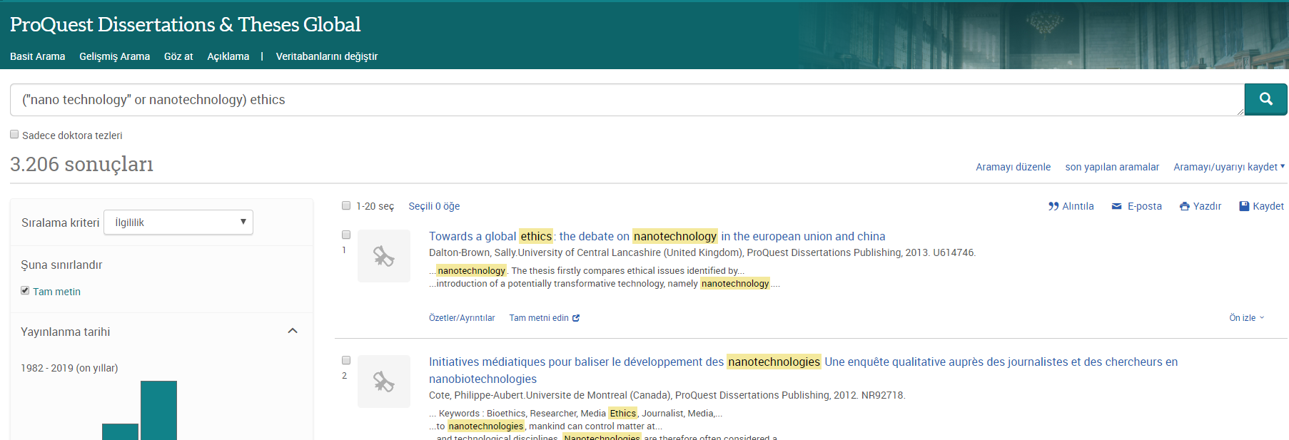
Arama Sonuçları: Tam metin seçimi, Filtreler ve Daha fazlası
Notes:
Mention Saving searches and Alerts options
To the left of the results page, you'll see the option to Sort and use Applied filters.
The Sort menu controls the sort order of the records that appear in the results page. Relevance is the default sort order.
Please use the Applied filters section to apply additional limits also known as filters or facets to refine your results. The limits are pulled from the list of available indexed/searchable fields that appear in the current result set. Some of the main limits you can expect to find include source, publication title, subject, language, and date.
The Cite tool generates a bibliography. Copy and paste the generated bibliography into a document and make any necessary edits. You can also Email or Print any selected records. Save records to a bibliographic manager like Endnote or Mandeley.
You can choose to search those books alongside your ProQuest platform databases. If your search strategy matches up to any ebooks available in your EBook Central collection, this tab will display those books.
At the bottom of the page, Other searches to try displays related and suggested subjects that you may consider searching on if you are dissatisfied with your current search results. The suggested subjects are related to your current keywords.

Slide 16
Arama Sonuçları: Tam metin seçimi, Filtreler ve Daha fazlası
Bir veya birden fazla öğeyi sonuç sayfasından seçerek alıntılama yapabilir, email olarak gönderebilir, yazdırabilir, araştırmam hesabınıza kaydedebilir ve bu aramanız için arama uyarısı oluşturabilirsiniz. Araştırmam hesabınıza kaydettiğiniz de her oturum açtığınızda bu belgelere erişebilirsiniz.
Alıntıla; seçeneği ile sonuç sayfasından seçmiş olduğunuz dokümanlar için açılır menüden seçeceğiniz atıf stili doğrultusunda bibliyografya oluşturabilirsiniz. Oluşturduğunuz bu bibliyografyayı kopyala/yapıştır işlemi ile belgenize aktarabilirsiniz.
Email; seçeneği ile sonuç sayfasından seçmiş olduğunuz dokümanları email olarak gönderebilirsiniz.
Notes:
Quick note about a couple of the terms I’ll be using . . .
As you may know, PQDT stands for ProQuest Dissertations and Theses. The “Global” is there to make clear that we have dissertations from all over the world. Most of the time, I’m just going to refer to the product by its initials: PQDT.
Also, when I say dissertations, I will be using the term as a shorthand for both dissertations (i.e., what PhD students write) and theses (i.e., what master’s students write).
In the most basic terms, then, PQDT is a database that researchers access on the ProQuest platform. It is the largest collection of dissertations in the world. The dissertations are written by graduate students from thousands of institutions in many different countries. As you will see later, some of these students have gone on to do important research. A few of them are even household names.

Slide 17
Arama Sonuçları: Tam metin seçimi, Filtreler ve Daha fazlası
Yazdır; seçeneği ile sonuç sayfasından seçmiş olduğunuz dokümanları yazdırabilirsiniz
Kaydet; seçeneği ile sonuç sayfasından seçmiş olduğunuz dokümanları Araştırmam hesabınıza kaydedebilirsiniz. Bu sayede Araştırmam hesabınızda her oturum açtığınızda bu belgelere erişebilirsiniz.
Uyarı oluştur; seçeneği ile yapmış olduğunuz arama için email uyarısı oluşturabilirsiniz. Bu şekilde yapmış olduğunuz arama ile ilişki platforma yeni doküman eklendiğinde email adresinize bu dokümanları içeren bir email iletilecektir.
Notes:
Quick note about a couple of the terms I’ll be using . . .
As you may know, PQDT stands for ProQuest Dissertations and Theses. The “Global” is there to make clear that we have dissertations from all over the world. Most of the time, I’m just going to refer to the product by its initials: PQDT.
Also, when I say dissertations, I will be using the term as a shorthand for both dissertations (i.e., what PhD students write) and theses (i.e., what master’s students write).
In the most basic terms, then, PQDT is a database that researchers access on the ProQuest platform. It is the largest collection of dissertations in the world. The dissertations are written by graduate students from thousands of institutions in many different countries. As you will see later, some of these students have gone on to do important research. A few of them are even household names.

Slide 18
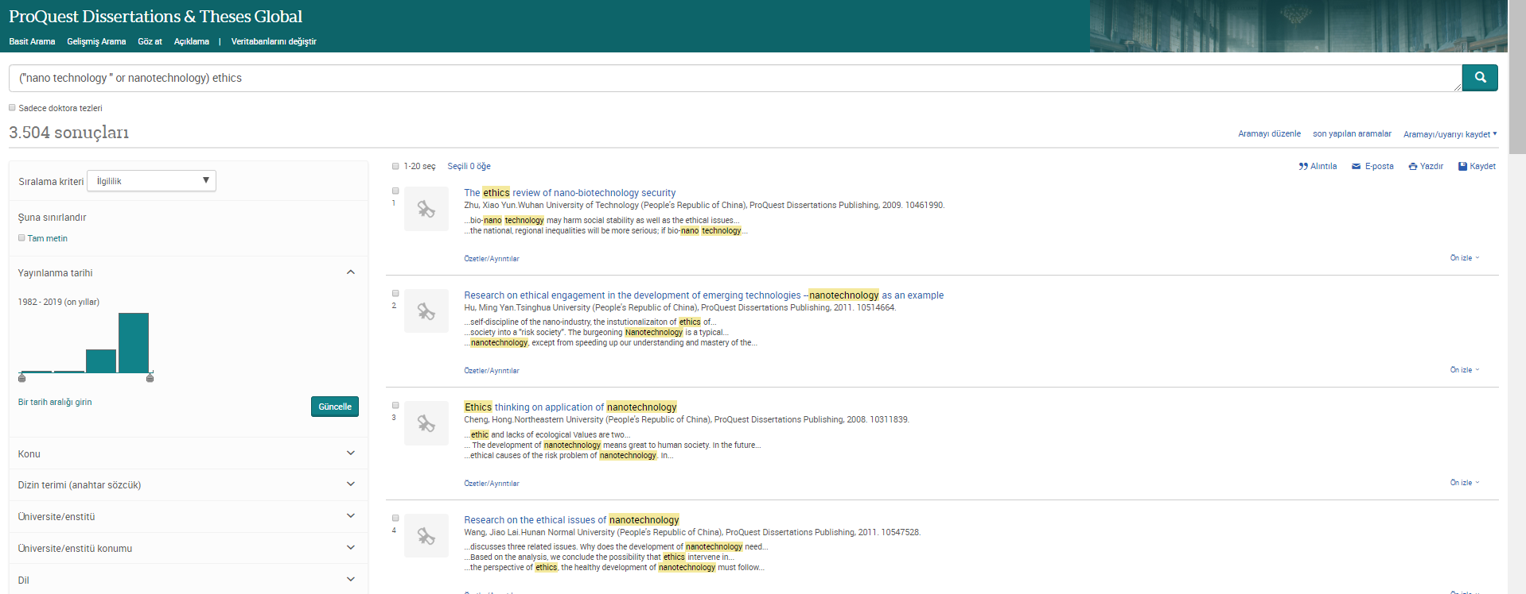
Arama Sonuçları: Tam metin seçimi, Filtreler ve Daha fazlası
Notes:
Mention Saving searches and Alerts options
To the left of the results page, you'll see the option to Sort and use Applied filters.
The Sort menu controls the sort order of the records that appear in the results page. Relevance is the default sort order.
Please use the Applied filters section to apply additional limits also known as filters or facets to refine your results. The limits are pulled from the list of available indexed/searchable fields that appear in the current result set. Some of the main limits you can expect to find include source, publication title, subject, language, and date.
The Cite tool generates a bibliography. Copy and paste the generated bibliography into a document and make any necessary edits. You can also Email or Print any selected records. Save records to a bibliographic manager like Endnote or Mandeley.
You can choose to search those books alongside your ProQuest platform databases. If your search strategy matches up to any ebooks available in your EBook Central collection, this tab will display those books.
At the bottom of the page, Other searches to try displays related and suggested subjects that you may consider searching on if you are dissatisfied with your current search results. The suggested subjects are related to your current keywords.

Slide 19
Arama Sonuçları: tam metin seçimi, filtreler ve daha fazlası
Sırala; Sonuç sayfasındaki sonuçlar dokümanların arama sorgunuz ile olan ilgililiğine göre sıralanır. Sırala seçeneğinden arzu ederseniz sonuçları güncel olanlar ilk sırada ya da eski olanlar ilk sırada şeklinde sonuçları sıralayabilirsiniz.
Sonuçları daralt; Sonuç sayfasındaki sonuçlar için arzu ederseniz bu bölümden farklı filitreleme seçenekleri kullanarak filitreleme gerçekleştirebilirsiniz. Tam metin, yayınlama tarihi, konu, dizin terimi, üniversite/enstitü, üniversite/enstitü konumu ve dil gibi farklı başlıklarda filitreler uygulayabilirsiniz.
Ön İzle; dokümanın tam metnini görüntülemeden doküman hakkındaki temel bilgileri görüntüleyebilirsiniz.
Notes:
Quick note about a couple of the terms I’ll be using . . .
As you may know, PQDT stands for ProQuest Dissertations and Theses. The “Global” is there to make clear that we have dissertations from all over the world. Most of the time, I’m just going to refer to the product by its initials: PQDT.
Also, when I say dissertations, I will be using the term as a shorthand for both dissertations (i.e., what PhD students write) and theses (i.e., what master’s students write).
In the most basic terms, then, PQDT is a database that researchers access on the ProQuest platform. It is the largest collection of dissertations in the world. The dissertations are written by graduate students from thousands of institutions in many different countries. As you will see later, some of these students have gone on to do important research. A few of them are even household names.

Slide 20
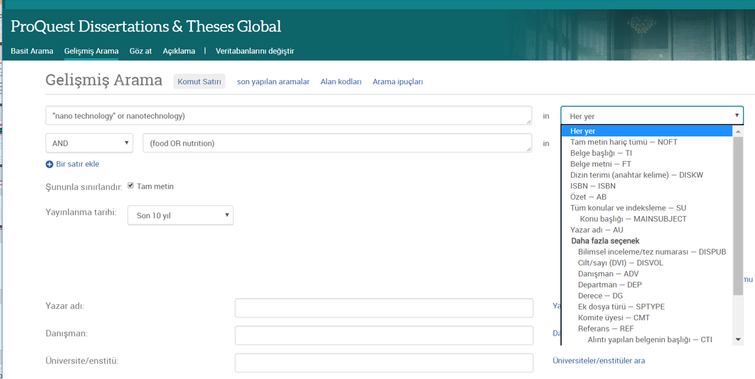
Gelişmiş Arama
Notes:
Perform a more detailed search using the pull-down menu with supported field codes as well as the More Search Options section to apply additional limits. Listed fields in the pull-down menu depend on the selected databases.
Use the ProQuest advanced search to create a search with specific fields and other options.
Use the drop-down menu from any row of search boxes to choose the type of information you want to search. Not all fields are searchable for every database. Enter the terms of your search in the boxes on the advanced search page.
[Search “groundwater pollution”] Restrict your search terms to specific field using the drop-down menu on each row. Use the look up link to find preferred terms when searching specific fields. You can also use that thesaurus to find subject headings of relevance. [search “hydraulic fracturing”] Use synonyms or variations of your search to broaden your list of results. Select the publication date range for your search. Limit your search by source type or other options. More search options depend on database selection.

Slide 21
Gelişmiş Arama
Daha detaylı arama gerçekleştirmek için gelişmiş arama seçeneğini kullanabilirsiniz. Açılır menüden herhangi bir seçim yapılmadığında varsayılan arama motoru arama kelimesini Her yer seçeneği ile tüm alanlarda arayacaktır.
Gelişmiş aramada arama yapmak istediğiniz arama sorgunuzu ilk kutucuğa yazarak açılır menüden hangi alanda arama yapmak istediğinizi seçebilirsiniz.
Notes:
Quick note about a couple of the terms I’ll be using . . .
As you may know, PQDT stands for ProQuest Dissertations and Theses. The “Global” is there to make clear that we have dissertations from all over the world. Most of the time, I’m just going to refer to the product by its initials: PQDT.
Also, when I say dissertations, I will be using the term as a shorthand for both dissertations (i.e., what PhD students write) and theses (i.e., what master’s students write).
In the most basic terms, then, PQDT is a database that researchers access on the ProQuest platform. It is the largest collection of dissertations in the world. The dissertations are written by graduate students from thousands of institutions in many different countries. As you will see later, some of these students have gone on to do important research. A few of them are even household names.

Slide 22
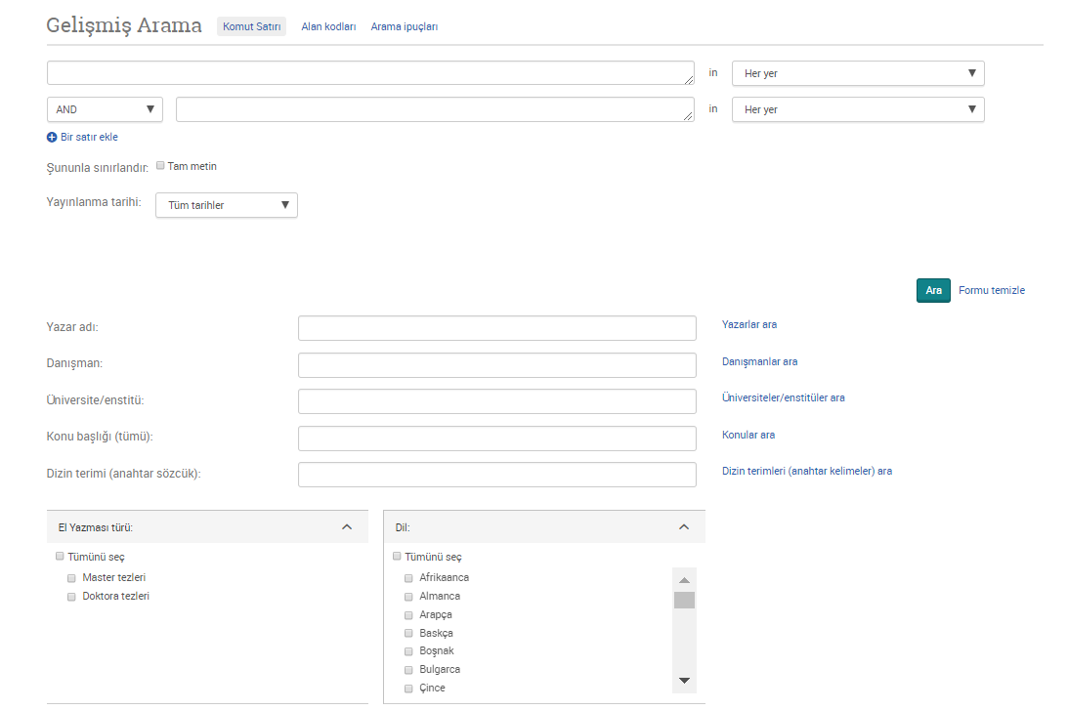
Gelişmiş Arama
Notes:
Perform a more detailed search using the pull-down menu with supported field codes as well as the More Search Options section to apply additional limits. Listed fields in the pull-down menu depend on the selected databases.
Use the ProQuest advanced search to create a search with specific fields and other options.
Use the drop-down menu from any row of search boxes to choose the type of information you want to search. Not all fields are searchable for every database. Enter the terms of your search in the boxes on the advanced search page.
[Search “groundwater pollution”] Restrict your search terms to specific field using the drop-down menu on each row. Use the look up link to find preferred terms when searching specific fields. You can also use that thesaurus to find subject headings of relevance. [search “hydraulic fracturing”] Use synonyms or variations of your search to broaden your list of results. Select the publication date range for your search. Limit your search by source type or other options. More search options depend on database selection.

Slide 23
Gelişmiş Arama
Bir satır ekle seçeneği ile daha fazla arama kriteri girebilirsiniz. Eğer birden çok arama terimini birleştirmek istiyorsanız bunun için AND, OR, NOT boolean operatörlerinden kullanmalısınız.
Arama sonuçlarınızı sadece Tam metin içerenler ile sınırlandırabilmektesiniz. Bunun için lütfen Şununla sınırlandır seçeneği yanındaki kutucuğu işaretleyiniz.
Yayınlanma tarihi alanında herhangi bir seçim yapılmadığında arama motoru Yayınlanma Tarihi için tüm tarihler içerisinde arama yapacaktır. İsterseniz bu bölümde farklı seçimler yapabilirsiniz.
Daha fazla arama seçeneği bölümümde; yazar adı, danışman, Üniversite/Enstitü, konu başlığı, dizin terimi alanına görmek istediğiniz bilgileri girebilirsiniz.
Ayrıca el yazması türü seçeneğinden sonuçlarınızı Master tezleri yada Doktora tezleri olarak filitreleyebilirsiniz. Dil seçeneğinden yapacağınız seçimler ile sonuçlarınıza dil filitresi uygulayabilirsiniz.
Notes:
Quick note about a couple of the terms I’ll be using . . .
As you may know, PQDT stands for ProQuest Dissertations and Theses. The “Global” is there to make clear that we have dissertations from all over the world. Most of the time, I’m just going to refer to the product by its initials: PQDT.
Also, when I say dissertations, I will be using the term as a shorthand for both dissertations (i.e., what PhD students write) and theses (i.e., what master’s students write).
In the most basic terms, then, PQDT is a database that researchers access on the ProQuest platform. It is the largest collection of dissertations in the world. The dissertations are written by graduate students from thousands of institutions in many different countries. As you will see later, some of these students have gone on to do important research. A few of them are even household names.

Slide 24
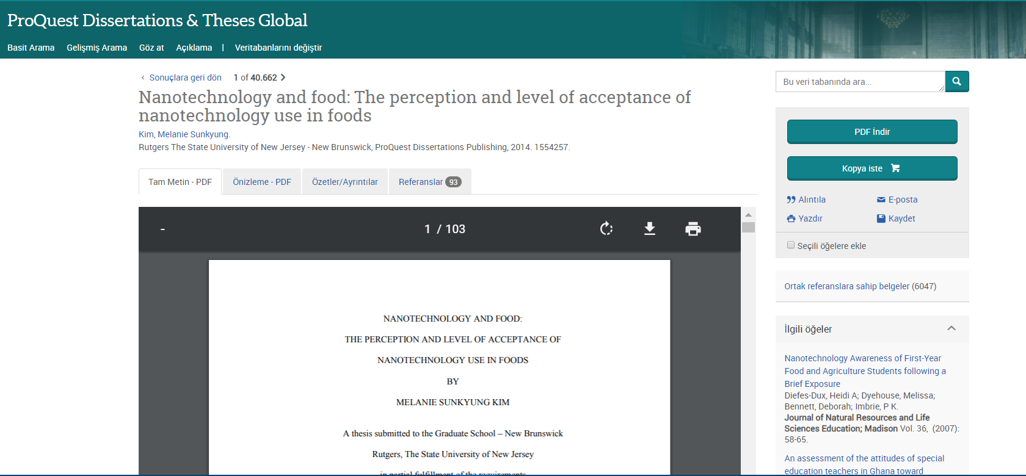
Döküman Görüntüleme
Notes:
HOW TO USE “CITED REFERENCES”
There’s an old adage that, “Research begets research.” While databases and indexes such as those provided by ProQuest are essential tools for discovering information, it is also important to examine the information that other authors rely upon. You may find a very useful reference that hadn’t turned up in your own search.
So, when you encounter a useful article in ProQuest, be sure to click on the “References” link and see what sources the authors used for their own research. Conveniently, many of them will be linked in ProQuest for ease of access.

Slide 25
Döküman görüntüleme
Eğer doküman tam metin olarak platformda yer alıyorsa bu durumda dokümanı tam metin PDF olarak görüntüleyebilir ya da doküman için PDF formatında önizleme gerçekleştirebilirsiniz. Ayrıca Özetler/Ayrıntılar seçeneğinden dokümanın özet bilgisine ve doküman ile ilgili diğer detay bilgilere erişebilirsiniz.
PDF İndir; seçeneği ile dokümanı PDF formatında bilgisayarınıza indirebilirsiniz.
Alıntıla; seçeneği ile dokümanın bibliyografik kaydını açılır menüden seçeceğiniz atıf stili ile düzenleyebilir ve kopyala/yapıştır yöntemi ile kaydedebilirsiniz.
Email; seçeneği ile dokümanı email olarak iletebilirsiniz.
Yazdır; seçeneği ile dokümanı yazdırabilirsiniz.
Kaydet; seçeneği ile sonuç sayfasından seçmiş olduğunuz dokümanları Araştırmam hesabınıza kaydedebilirsiniz.
Notes:
Quick note about a couple of the terms I’ll be using . . .
As you may know, PQDT stands for ProQuest Dissertations and Theses. The “Global” is there to make clear that we have dissertations from all over the world. Most of the time, I’m just going to refer to the product by its initials: PQDT.
Also, when I say dissertations, I will be using the term as a shorthand for both dissertations (i.e., what PhD students write) and theses (i.e., what master’s students write).
In the most basic terms, then, PQDT is a database that researchers access on the ProQuest platform. It is the largest collection of dissertations in the world. The dissertations are written by graduate students from thousands of institutions in many different countries. As you will see later, some of these students have gone on to do important research. A few of them are even household names.

Slide 26
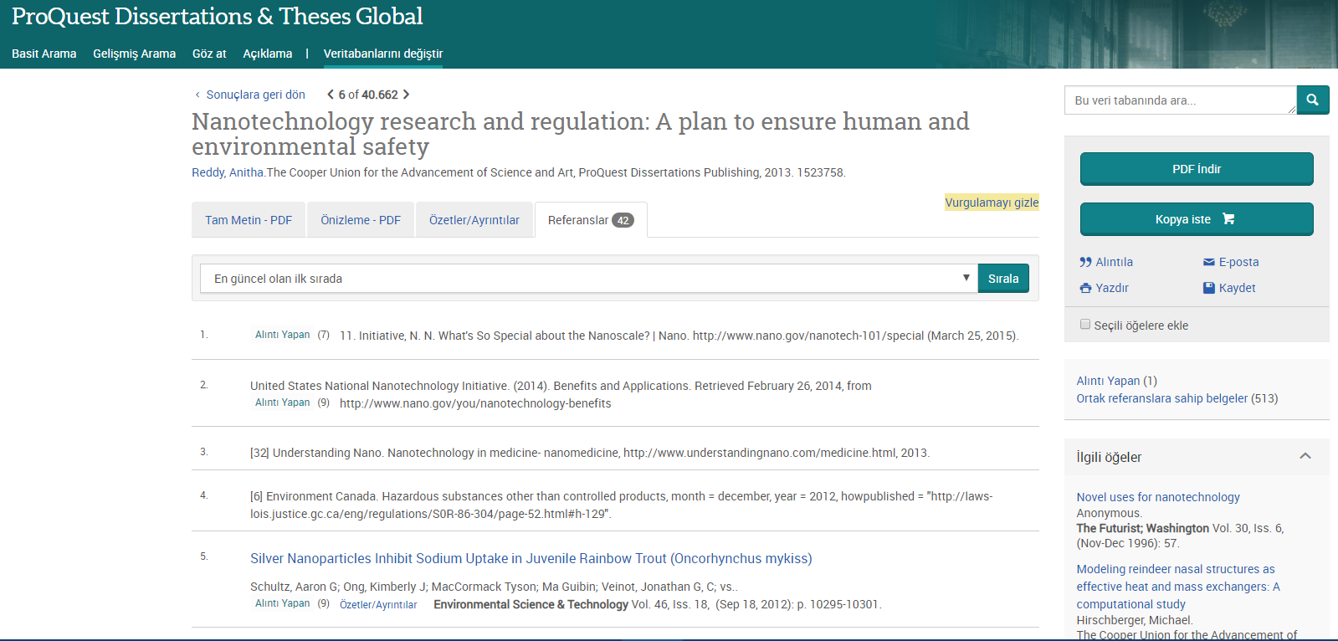
Döküman Görüntüleme
Notes:
HOW TO USE “CITED REFERENCES”
There’s an old adage that, “Research begets research.” While databases and indexes such as those provided by ProQuest are essential tools for discovering information, it is also important to examine the information that other authors rely upon. You may find a very useful reference that hadn’t turned up in your own search.
So, when you encounter a useful article in ProQuest, be sure to click on the “References” link and see what sources the authors used for their own research. Conveniently, many of them will be linked in ProQuest for ease of access.

Slide 27
Döküman görüntüleme
Referanslar: Doküman içerisinde, yazar ve yayıncı tarafından sağlanan, düşünce ve düşünceleri desteklemek için kullanılan kaynakların alıntılarını içerir. Referans bir link içeriyorsa bu doküman kurumunuz tarafından erişilebilen başka bir ProQuest kaynağı içerisinden erişilebilmektedir. Dokümana tıklayarak bu yayına erişebilirsiniz.
Ortak referanslara sahip belgeler; seçeneği ile bu doküman ile aynı referanslara sahip diğer ProQuest dokümanlarına erişebilirsiniz.
İlgili Öğeler; Bu incelediğiniz dokümanın içeriği ile en ilgili diğer ProQuest dokümanları için platform size önerilerde bulunmaktadır.
Notes:
Quick note about a couple of the terms I’ll be using . . .
As you may know, PQDT stands for ProQuest Dissertations and Theses. The “Global” is there to make clear that we have dissertations from all over the world. Most of the time, I’m just going to refer to the product by its initials: PQDT.
Also, when I say dissertations, I will be using the term as a shorthand for both dissertations (i.e., what PhD students write) and theses (i.e., what master’s students write).
In the most basic terms, then, PQDT is a database that researchers access on the ProQuest platform. It is the largest collection of dissertations in the world. The dissertations are written by graduate students from thousands of institutions in many different countries. As you will see later, some of these students have gone on to do important research. A few of them are even household names.

Slide 28
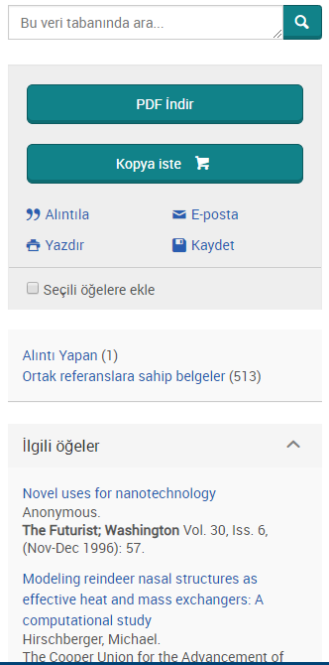
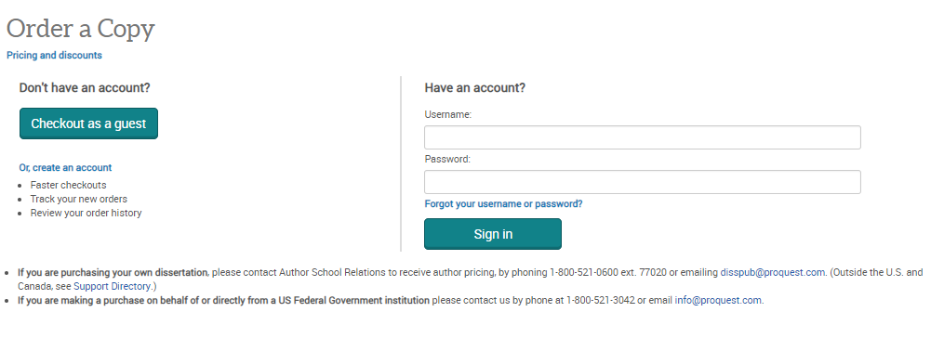
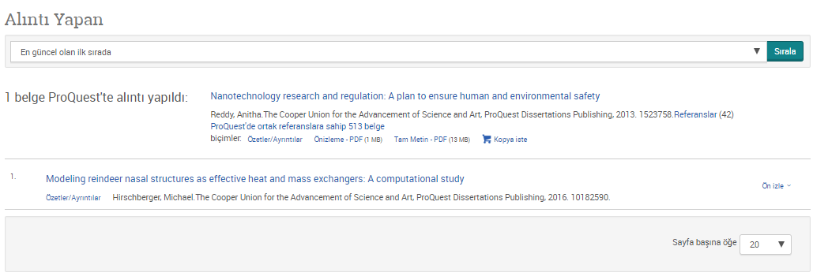
Döküman Görüntüleme
Notes:
HOW TO USE “CITED REFERENCES”
There’s an old adage that, “Research begets research.” While databases and indexes such as those provided by ProQuest are essential tools for discovering information, it is also important to examine the information that other authors rely upon. You may find a very useful reference that hadn’t turned up in your own search.
So, when you encounter a useful article in ProQuest, be sure to click on the “References” link and see what sources the authors used for their own research. Conveniently, many of them will be linked in ProQuest for ease of access.

Slide 29
Döküman görüntüleme
Kopya İste: Bu butona tıklayarak bir hesap oluşturduktan sonra belli bir ücret karşılığında tezin tam metinin kendinize basılı olarak gönderilmesini isteyebilirsiniz.
Alıntı yapan; seçeneği ile bu dokümandan alıntı yapmış diğer ProQuest dokümanlarına erişebilirsiniz.
Notes:
Quick note about a couple of the terms I’ll be using . . .
As you may know, PQDT stands for ProQuest Dissertations and Theses. The “Global” is there to make clear that we have dissertations from all over the world. Most of the time, I’m just going to refer to the product by its initials: PQDT.
Also, when I say dissertations, I will be using the term as a shorthand for both dissertations (i.e., what PhD students write) and theses (i.e., what master’s students write).
In the most basic terms, then, PQDT is a database that researchers access on the ProQuest platform. It is the largest collection of dissertations in the world. The dissertations are written by graduate students from thousands of institutions in many different countries. As you will see later, some of these students have gone on to do important research. A few of them are even household names.

Slide 30
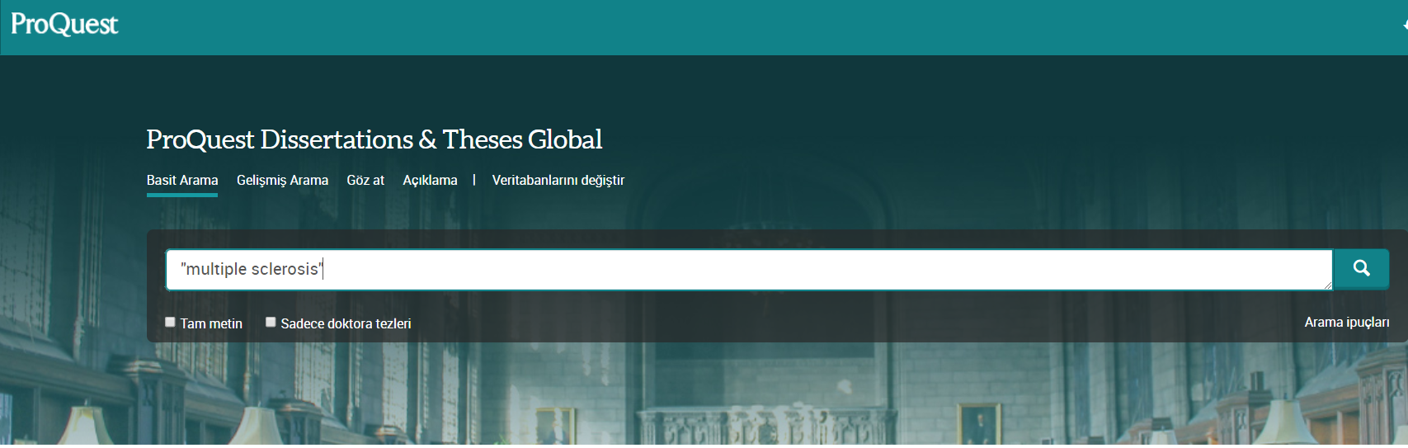
Basit Arama DEMO
Bir araştırma konunuz var ve bununla ilgili platformda yer alan tezleri incelemek istiyorsunuz. Örneğin MS hastalığı olarak ifade ettiğimiz "Multiple Sclerosis". (İki kelimeden oluşan arama kelimelerinizi tırnak işaretleri içerisinde yazarak daha doğru sonuçlara ulaşabilirsiniz). Bu aslında temel çıkış noktanız. Arama kutucuğuna arama kelimenizi yazıp “ARA” butonuna bastığınız zaman tüm bu içerikteki sonuçlara (master tezlerine, doktora tezlerine, tam metin ve özet bilgisi olan tezler) ulaşırsınız.
Notes:
Quick note about a couple of the terms I’ll be using . . .
As you may know, PQDT stands for ProQuest Dissertations and Theses. The “Global” is there to make clear that we have dissertations from all over the world. Most of the time, I’m just going to refer to the product by its initials: PQDT.
Also, when I say dissertations, I will be using the term as a shorthand for both dissertations (i.e., what PhD students write) and theses (i.e., what master’s students write).
In the most basic terms, then, PQDT is a database that researchers access on the ProQuest platform. It is the largest collection of dissertations in the world. The dissertations are written by graduate students from thousands of institutions in many different countries. As you will see later, some of these students have gone on to do important research. A few of them are even household names.

Slide 31

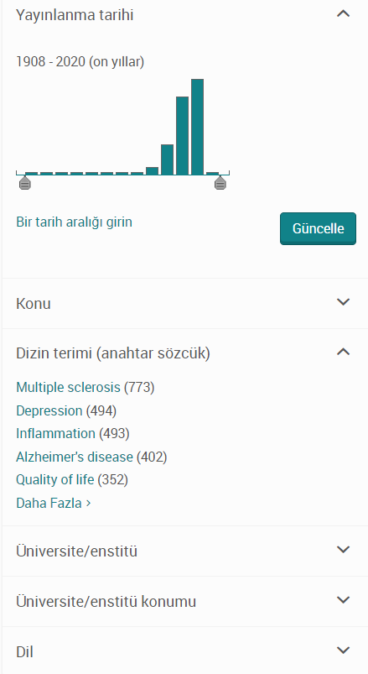
Basit Arama DEMO
Aramanızı daha detaylandırmak isteyebilirsiniz. Örneğin; MS hastalığı ile ilgili çocuklar konusunda yapılan çalışmaları incelemek isteyebilirsiniz.
Bunun için araştırma konunuz ile ilgili filitrelendirmeler yapabilirsiniz. Örneğin; “Dizin Terimi (Anahtar Sözcük)” filitrelendirme bölümünde yazdığınız araştırma konunuz ile ilgili platform sizlere birçok anahtar kelime seçeneği sunacaktır. Her filitrelendirme seçeneğinde “Daha Fazla” diyerek tüm seçenekleri görüntüleyebilirsiniz.
Notes:
Quick note about a couple of the terms I’ll be using . . .
As you may know, PQDT stands for ProQuest Dissertations and Theses. The “Global” is there to make clear that we have dissertations from all over the world. Most of the time, I’m just going to refer to the product by its initials: PQDT.
Also, when I say dissertations, I will be using the term as a shorthand for both dissertations (i.e., what PhD students write) and theses (i.e., what master’s students write).
In the most basic terms, then, PQDT is a database that researchers access on the ProQuest platform. It is the largest collection of dissertations in the world. The dissertations are written by graduate students from thousands of institutions in many different countries. As you will see later, some of these students have gone on to do important research. A few of them are even household names.

Slide 32
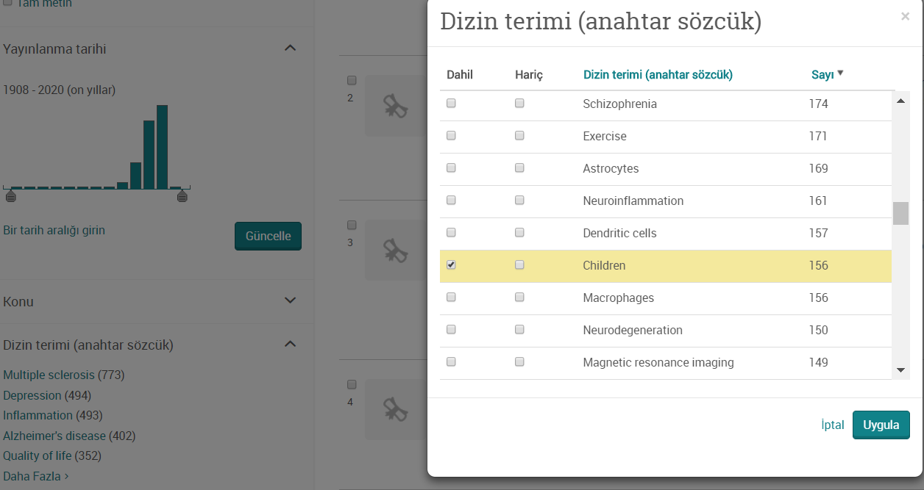
Basit Arama DEMO
Çocuklar ile ilgili yapılan çalışmaları incelemek istediğiniz için DAHİL sütünundan ilgili arama kelimeleri seçebilirsiniz. Örneğin “children” seçimini yapıp “Uygula” demelisiniz. Uygula dediğiniz de sonuç sayfası güncellenecektir.
NOT: Ayrıca seçim yaparken yaptığınız seçimin hemen karşısında bu konuda platformda ne kadar sayıda tez olduğunu görebilirsiniz.
Notes:
Quick note about a couple of the terms I’ll be using . . .
As you may know, PQDT stands for ProQuest Dissertations and Theses. The “Global” is there to make clear that we have dissertations from all over the world. Most of the time, I’m just going to refer to the product by its initials: PQDT.
Also, when I say dissertations, I will be using the term as a shorthand for both dissertations (i.e., what PhD students write) and theses (i.e., what master’s students write).
In the most basic terms, then, PQDT is a database that researchers access on the ProQuest platform. It is the largest collection of dissertations in the world. The dissertations are written by graduate students from thousands of institutions in many different countries. As you will see later, some of these students have gone on to do important research. A few of them are even household names.

Slide 33
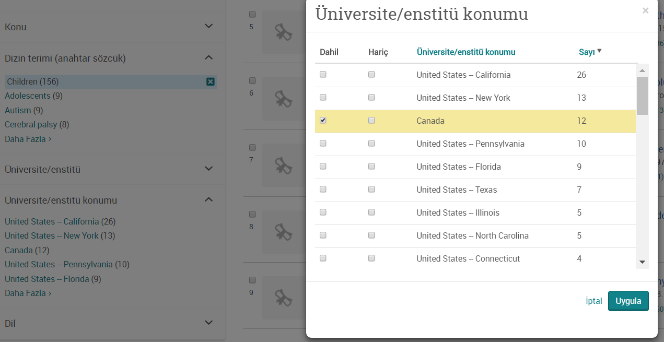
Basit Arama DEMO
Bunun dışında birçok Ülkede ve Üniversitede bu konu hakkında yayınlamış tezler platformda mevcuttur. Sizler araştırma konunuz ile ilgili spesifik bir bölge yayınlanmış tezleri incelemek isteyebilirsiniz. Örneğin “Canada”. “Üniversite/Enstitü konumu” bölümünden bölge seçimini yapıp “Uygula” demeniz yeterli.
Notes:
Quick note about a couple of the terms I’ll be using . . .
As you may know, PQDT stands for ProQuest Dissertations and Theses. The “Global” is there to make clear that we have dissertations from all over the world. Most of the time, I’m just going to refer to the product by its initials: PQDT.
Also, when I say dissertations, I will be using the term as a shorthand for both dissertations (i.e., what PhD students write) and theses (i.e., what master’s students write).
In the most basic terms, then, PQDT is a database that researchers access on the ProQuest platform. It is the largest collection of dissertations in the world. The dissertations are written by graduate students from thousands of institutions in many different countries. As you will see later, some of these students have gone on to do important research. A few of them are even household names.

Slide 34
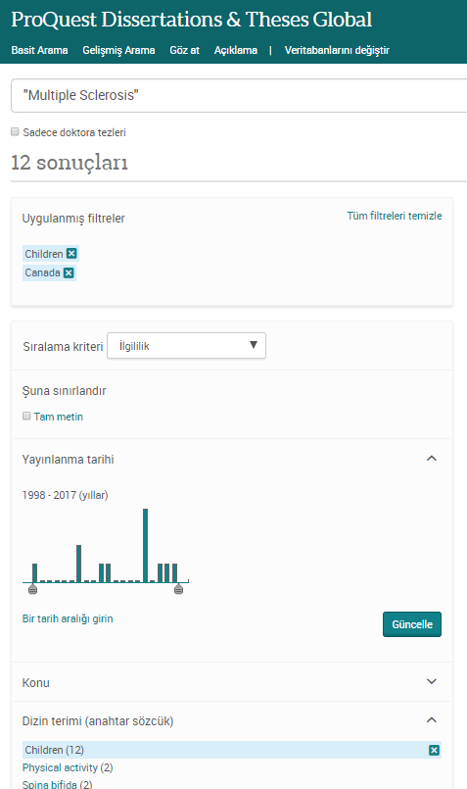
Basit Arama DEMO
Seçmiş olduğunuz filitrelendirmeler dışında başka filitrelendirme seçeneklerinden de isterseniz seçimler yapabilirsiniz.(Yayınlanma Tarihi, Konu, Üniversite Enstitü, Dil) Ne kadar doğru seçimler yaparsanız daha odaklı sonuçlara ulaşabilir ve sonuçları daha verimli inceleyebilirsiniz.
Yaptığınız seçimler sonrasında sonuç sayfasında 12 sonuç bulunmaktadır. Bu bizim için oldukça odaklı bir sonuçtur. Bu sonuçlar içerisinde hem tam metin hem de özet bilgisine sahip tezler yer almaktadır. Sonuç sayfasında sadece Tam Metin sonuçları görmek isterseniz Tam Metin seçimini yapabilirsiniz.
NOT:Bundan sonra platform üzerinde yapılacak tüm işlem detaylarına önceki slaytlardan inceleyebilirsiniz.
Notes:
Quick note about a couple of the terms I’ll be using . . .
As you may know, PQDT stands for ProQuest Dissertations and Theses. The “Global” is there to make clear that we have dissertations from all over the world. Most of the time, I’m just going to refer to the product by its initials: PQDT.
Also, when I say dissertations, I will be using the term as a shorthand for both dissertations (i.e., what PhD students write) and theses (i.e., what master’s students write).
In the most basic terms, then, PQDT is a database that researchers access on the ProQuest platform. It is the largest collection of dissertations in the world. The dissertations are written by graduate students from thousands of institutions in many different countries. As you will see later, some of these students have gone on to do important research. A few of them are even household names.

Slide 35
ProQuest Destek Kaynakları

Slide 36
ProQuest Destek Kaynakları
LibGuide:
Türkçe: http://proquest.libguides.com/PQDT
ProQuest Dissertations&Theses Türkçe Video sayfası
https://www.proquest.com/go/turkishvideos
ProQuest Dissertations&Theses Global ile ilgili sorularınız için destek ekibi ile iletişime geçin:
Email.TechnicalSupport@proquest.com
training@proquest.com

Slide 37
Sonuç olarak;
Bu oturumdan sonra yapabilecekleriniz;
Platformun kullanımı hakkında bilgi sahibi olacak ve araştırmanızla ilgili bilgileri keşfedip yönetebileceksiniz.
Akademik araştırmanızı ilgili veriler ve görüşlerle güçlendirebileceksiniz.
Araştırma alanınız ile ilgili güncel bilgilere erişebileceksiniz.
Notes:
Also offer attendance to an advanced session

Slide 38
Hazal Yılmaz-Teknik Eğitim ve Danışmanlık Ortağı

